Slide 1
Routing in Telephone Networks

Slide 2
What is it?
Process of finding a path from a source to every destination in the network
Suppose you want to connect to Antarctica from your desktop
  what route should you take?
  does a shorter route exist?
  what if a link along the route goes down?
  what if you’re on a mobile wireless link?
Routing deals with these types of issues

Slide 3
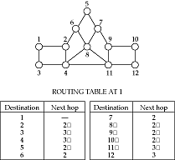
Basics
A routing protocol sets up a routing table in routers and switch controllers
A node makes a local choice depending on global topology: this is the fundamental problem

Slide 4
Key problem
How to make correct local decisions?
  each router must know something about global state
Global state
  inherently large
  dynamic
  hard to collect
A routing protocol must intelligently summarize relevant information

Slide 5
Requirements
Minimize routing table space
  fast to look up
  less to exchange
Minimize number and frequency of control messages
Robustness: avoid
  black holes
  loops
  oscillations
Use optimal path

Slide 6
Choices
Centralized vs. distributed routing
  centralized is simpler, but prone to failure and congestion
Source-based vs. hop-by-hop
  how much is in packet header?
  Intermediate: loose source route
Stochastic vs. deterministic
  stochastic spreads load, avoiding oscillations, but misorders
Single vs. multiple path
  primary and alternative paths (compare with stochastic)
State-dependent vs. state-independent
  do routes depend on current network state (e.g. delay)

Slide 7
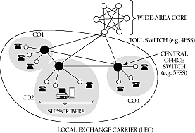
Telephone network topology
3-level hierarchy, with a fully-connected core
AT&T: 135 core switches with nearly 5 million circuits
LECs may connect to multiple cores

Slide 8
Routing algorithm
If endpoints are within same CO, directly connect
If call is between COs in same LEC, use one-hop path between COs
Otherwise send call to one of the cores
Only major decision is at toll switch
  one-hop or two-hop path to the destination toll switch
  (why don’t we need longer paths?)
Essence of problem
  which two-hop path to use if one-hop path is full

Slide 9
Features of telephone network routing
Stable load
  can predict pairwise load throughout the day
  can choose optimal routes in advance
Extremely reliable switches
  downtime is less than a few minutes per year
  can assume that a chosen route is available
  can’t do this in the Internet
Single organization controls entire core
  can collect global statistics and implement global changes
Very highly connected network
Connections require resources (but all need the same)

Slide 10
Statistics
Posson call arrival (independence assumption)
Exponential call “holding” time (length!)
Goal:- Minimise Call “Blocking” (aka “loss”) Probability subject to minimise cost of network

Slide 11
The cost of simplicity
Simplicity of routing a historical necessity
But requires
  reliability in every component
  logically fully-connected core
Can we build an alternative that has same features as the telephone network, but is cheaper because it uses more sophisticated routing?
  Yes: that is one of the motivations for ATM
  But 80% of the cost is in the local loop
    not affected by changes in core routing
  Moreover, many of the software systems assume topology
    too expensive to change them

Slide 12
Dynamic nonhierarchical routing (DNHR)
Simplest core routing protocol
  accept call if one-hop path is available, else drop
DNHR
  divides day into around 10-periods
  in each period, each toll switch is assigned a primary one-hop path and a list of alternatives
  can overflow to alternative if needed
  drop only if all alternate paths are busy
    crankback
Problems
  does not work well if actual traffic differs from prediction

Slide 13
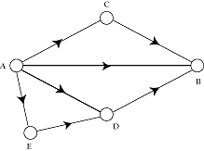
Metastability
Burst of activity can cause network to enter metastable state
  high blocking probability even with a low load
Removed by trunk reservation
  prevents spilled traffic from taking over direct path

Slide 14
Trunk status map routing (TSMR)
DNHR measures traffic once a week
TSMR updates measurements once an hour or so
  only if it changes “significantly”
List of alternative paths is more up to date

Slide 15
Real-time network routing
No centralized control
  Each toll switch maintains a list of lightly loaded links
  Intersection of source and destination lists gives set of lightly loaded paths
Example
  At A, list is C, D, E => links AC, AD, AE lightly loaded
  At B, list is D, F, G => links BD, BF, BG lightly loaded
  A asks B for its list
  Intersection = D => AD and BD lightly loaded => ADB lightly loaded => it is a good alternative path
Very effective in practice: only about a couple of calls blocked in core out of about 250 million calls attempted every day

Slide 16
Dynamic Alternative Routing
Very simple idea, but can be shown to provide optimal routes at very low complexity…

Slide 17
Underlying Network Properties
Fully connected network
  Underlying network is a trunk network
Relatively small number of nodes
  In 1986, the trunk network of British Telecom had only 50 nodes
  Any algorithm with polynomial running time works fine
Stochastic traffic
  Low variance when the link is nearly saturated

Slide 18
Dynamic Alternative Routing
Proposed by F.P. Kelly, R. Gibbens at British Telecom (well, Cambridge, Really:)
Whenever the link (i, j) is saturated, use an alternative node (tandem)
Q. How to choose tandem?
C_{i,j}
i
j
k

Slide 19
Fixed Tandem
For any pair of nodes (i, j) we assign a fixed node k as tandem
Needs careful traffic analysis and reprogramming
Inflexible during breakdowns and unexpected traffic at tandem

Slide 20
Sticky Random Tandem
If there is no free circuit along (i, j), a new call is routed through a randomly chosen tandem k
k is the tandem as long as it does not fail
If k fails for a call, the call is lost and a new tandem is selected

Slide 21
Sticky Random Tandem
Decentralized and flexible
No fancy pre-analysis of traffic required
Most of the time friendly tandems are used:
  p_{k}(i, j): proportion of calls between i and j which go through k
  q_{k}(i, j): proportion of calls that are blocked
  p_{a}(i, j)q_{a}(i, j) = p_{b}(i, j)q_{b}(i, j)
We may assign different frequencies to different tandems

Slide 22
Trunk Reservation
Unselfishness towards one’s friends is good up to a point!!!
We need to penalize two link calls, at least when the lines are very busy!
i
j
k
A tandem k accepts to forward calls if it has free capacity more than R

Slide 23
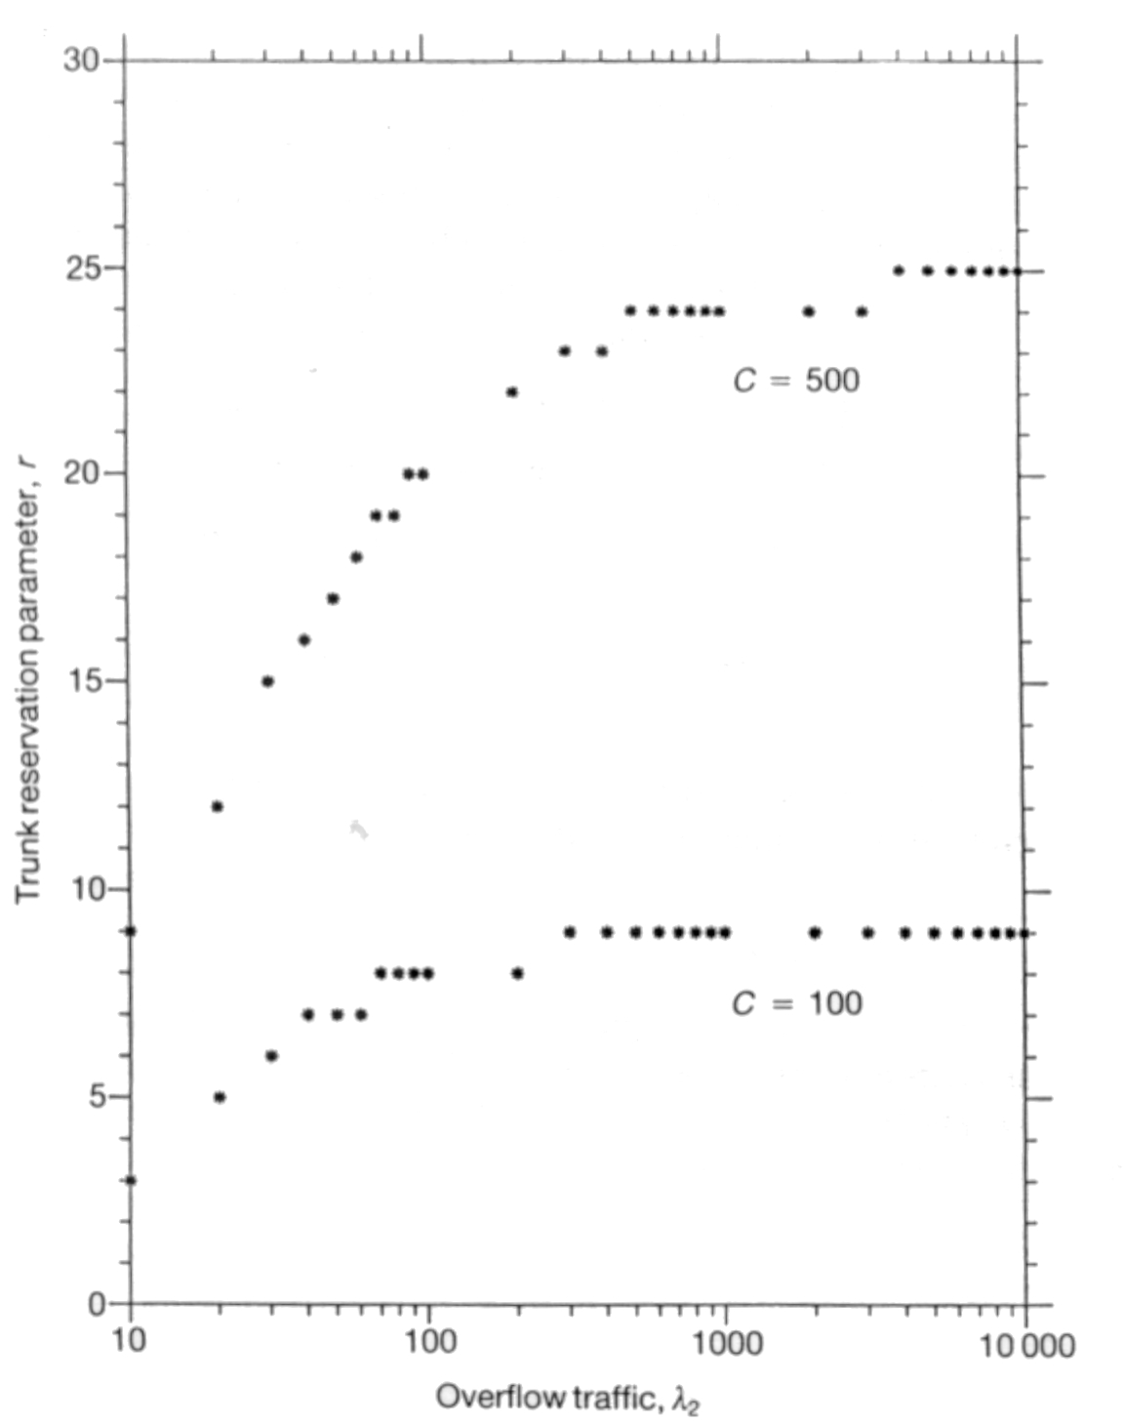
Trunk Reservation

Slide 24
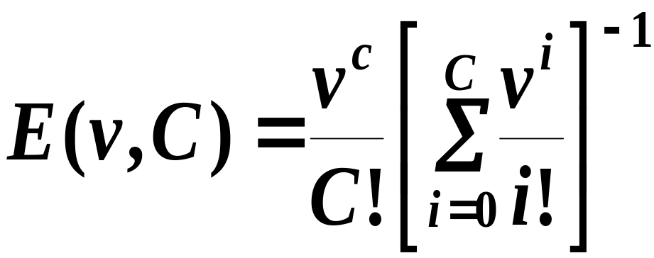
Bounds: Erlang’s Bound
A node connected to C circuits
Arrival: Poisson with mean v
The expected value of blocking:

Slide 25
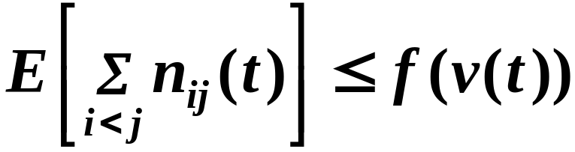
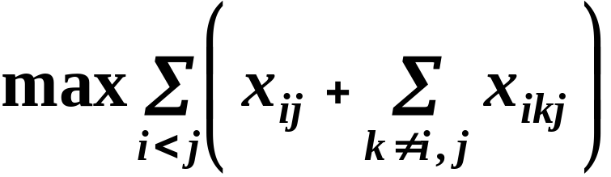
Max-flow Bound
Capacity of (i, j): C_{ij}
Mean load on (i, j): v_{ij}
where f is:
C_{ij}
i
j
k
Notes:
Constraints:

Slide 26
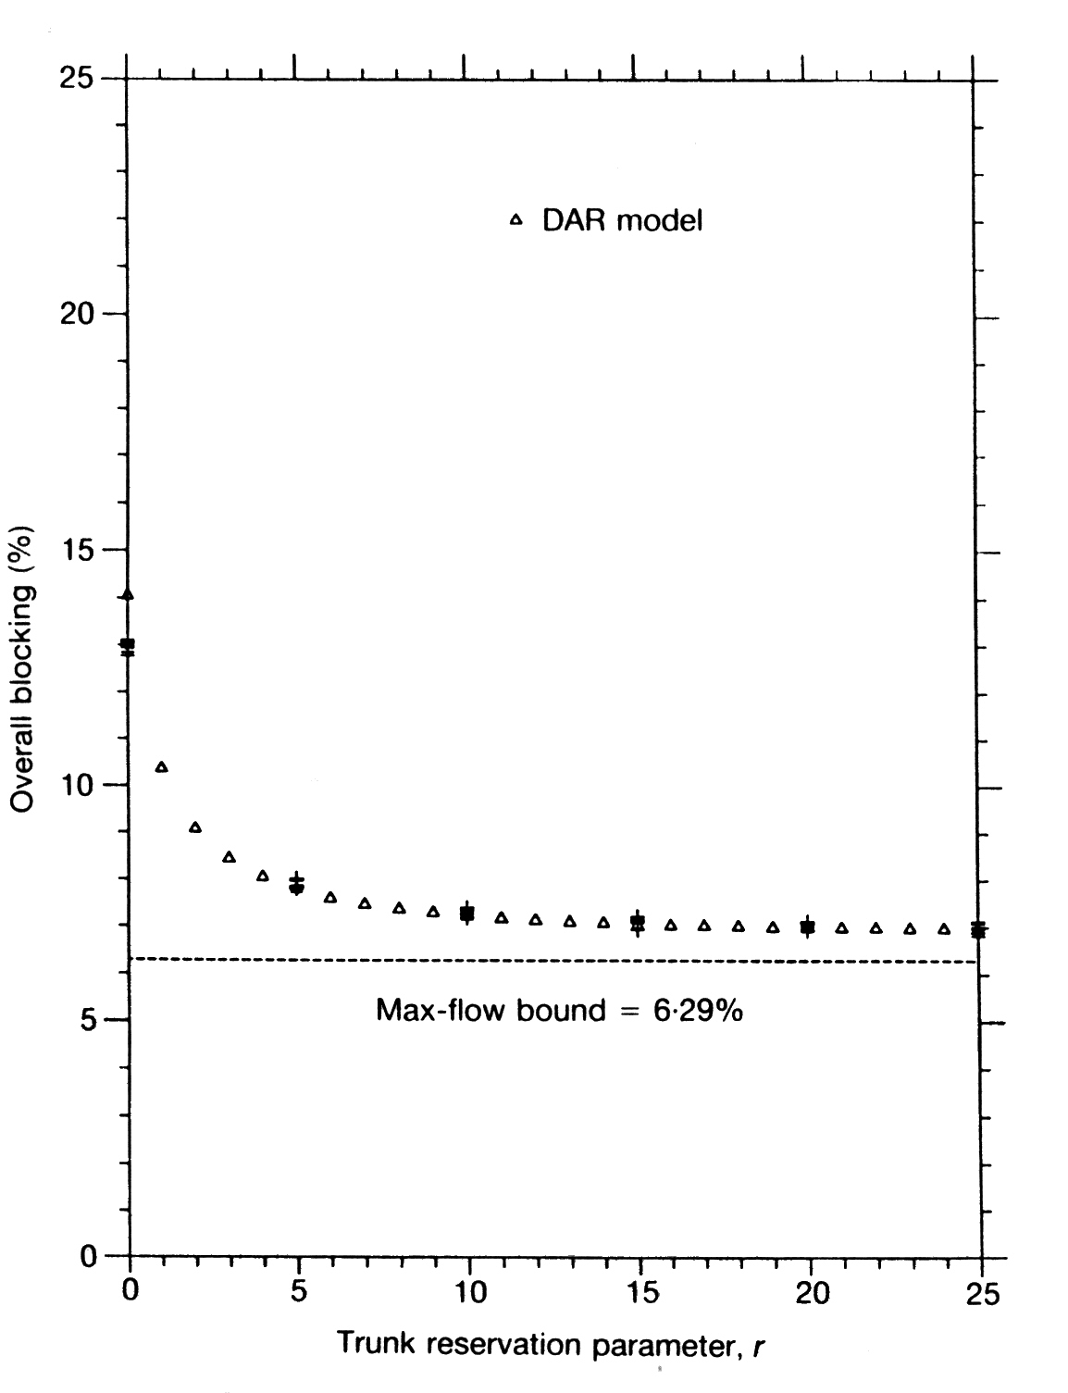
Trunk Reservation

Slide 27
Traffic, Capacity Mismatch
Traffic > Capacity for some links
Can we always find a feasible set of tandems?
Red links: saturated links
White links: not saturated
Good triangle: one red, two white links

Slide 28
Greedy Algorithm
a. No red links
b. Red link and a good triangle
  Add good triangle to the list
c. Red link and no good triangle
Success!
Success!
T₁
T_{k+1}
T_{k}
T₂
Fail

Slide 29
Extensions to DAR
n-link paths
  Too much resources consumed, little benefit
Multiple alternatives
  M attempts before rejecting a call
Least-busy alternative
Repacking
  A call in progress can be rerouted

Slide 30
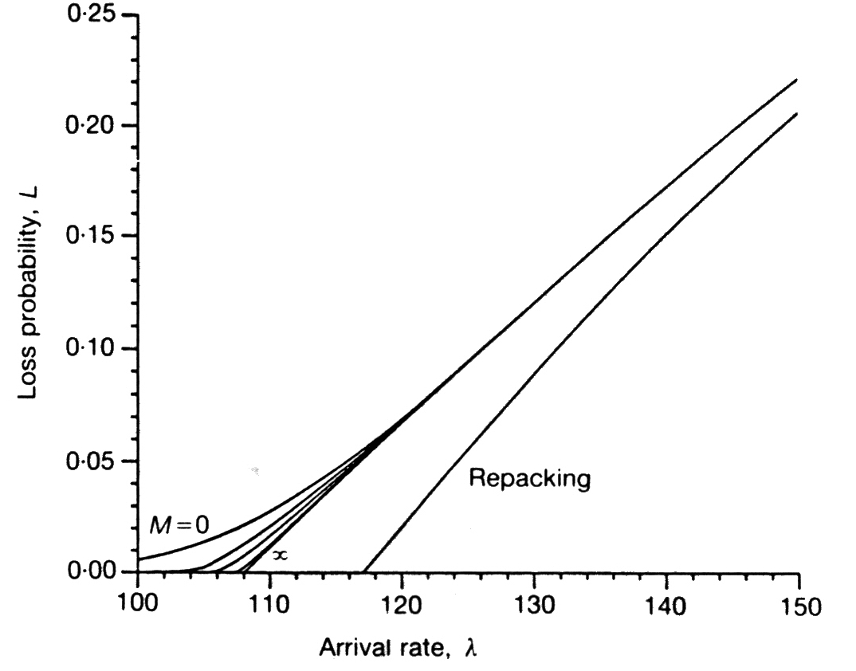
Comparison of Extensions

Slide 31
Features of Internet Routing
Packets, not circuits (
  E.g. timescales can be much shorter
Topology complicated/heterogeneous
Many (10,000 ++) providers
Traffic sources bursty
Traffic matrix unpredictable
  E.g. Not distance constrained
Goal: maximise throughput, subject to min delay and cost (and energy?)

Slide 32
Internet Routing Model
2 key features:
  Dynamic routing
  Intra- and Inter-AS routing, AS = locus of admin control
Internet organized as “autonomous systems” (AS).
  AS is internally connected
Interior Gateway Protocols (IGPs) within AS.
  Eg: RIP, OSPF, HELLO
Exterior Gateway Protocols (EGPs) for AS to AS routing.
  Eg: EGP, BGP-4

Slide 33
Requirements for Intra-AS Routing
Should scale for the size of an AS.
  Low end: 10s of routers (small enterprise)
  High end: 1000s of routers (large ISP)
Different requirements on routing convergence after topology changes
  Low end: can tolerate some connectivity disruptions
  High end: fast convergence essential to business (making money on transport)
Operational/Admin/Management (OAM) Complexity
  Low end: simple, self-configuring
  High end: Self-configuring, but operator hooks for control
Traffic engineering capabilities: high end only

Slide 34
Requirements for Inter-AS Routing
Should scale for the size of the global Internet.
  Focus on reachability, not optimality
  Use address aggregation techniques to minimize core routing table sizes and associated control traffic
  At the same time, it should allow flexibility in topological structure (eg: don’t restrict to trees etc)
Allow policy-based routing between autonomous systems
  Policy refers to arbitrary preference among a menu of available options (based upon options’ attributes)
  In the case of routing, options include advertised AS-level routes to address prefixes
  Fully distributed routing (as opposed to a signaled approach) is the only possibility.
  Extensible to meet the demands for newer policies.

Slide 35
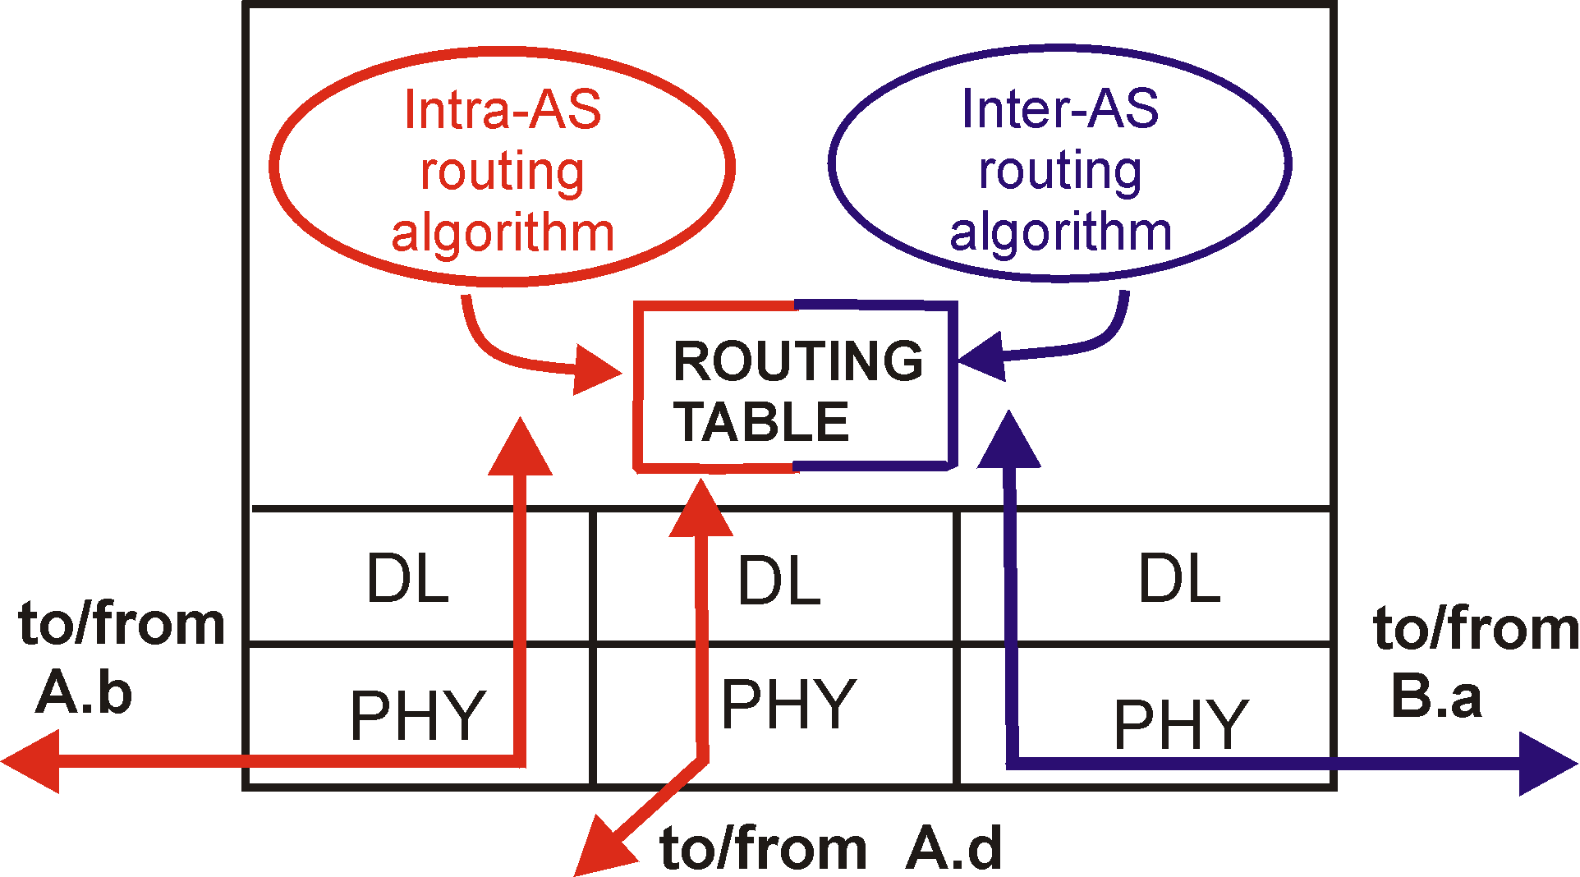
Intra-AS and Inter-AS routing
C.b
Gateways:
  perform inter-AS routing amongst themselves
  perform intra-AS routers with other routers in their AS
B.a
A.a
b
A.c
c
a
C
a
b
a
B
d
c
A
b
network layer
inter-AS,
intra-AS
routing in
gateway A.c
link layer
physical layer

Slide 36

Intra-AS and Inter-AS routing: Example
Inter-AS
routing
between
A and B
C.b
B.a
A.a
Host
h2
b
A.c
c
a
C
a
b
a
B
Host
h1
d
c
Intra-AS routing
within AS B
A
b
Intra-AS routing
within AS A

Slide 37
Basic Dynamic Routing Methods
Source-based: source gets a map of the network,
  source finds route, and either
  signals the route-setup (eg: ATM approach)
  encodes the route into packets (inefficient)
Link state routing: per-link information
  Get map of network (in terms of link states) at all nodes and find next-hops locally.
  Maps consistent => next-hops consistent
Distance vector: per-node information
  At every node, set up distance signposts to destination nodes (a vector)
  Setup this by peeking at neighbors’ signposts.

Slide 38
DV & LS: consistency criterion
The subset of a shortest path is also the shortest path between the two intermediate nodes.
Corollary:
  If the shortest path from node i to node j, with distance D(i,j) passes through neighbor k, with link cost c(i,k), then:
      D(i,j) = c(i,k) + D(k,j)
j
i
D(k,j)
c(i,k)
k

Slide 39
Hierarchical routing
Large networks need large routing tables
  more computation to find shortest paths
  more bandwidth wasted on exchanging DVs and LSPs
Solution:
  hierarchical routing
Key idea
  divide network into a set of domains
  gateways connect domains
  computers within domain unaware of outside computers
  gateways know only about other gateways

Slide 40
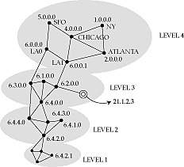
Example
Features
  only a few routers in each level
  not a strict hierarchy
  gateways participate in multiple routing protocols
  non-aggregable routers increase core table space

Slide 41
Hierarchy in the Internet
Three-level hierarchy in addresses
  network number
  subnet number/more specific prefix
  host number
Core advertises routes only to networks, not to subnets
  e.g. 135.104.*, 192.20.225.*
Even so, about 80,000 networks in core routers (1996)
Gateways talk to backbone to find best next-hop to every other network in the Internet

Slide 42
External and summary records
If a domain has multiple gateways
  external records tell hosts in a domain which one to pick to reach a host in an external domain
    e.g allows 6.4.0.0 to discover shortest path to 5.* is through 6.0.0.0
  summary records tell backbone which gateway to use to reach an internal node
    e.g. allows 5.0.0.0 to discover shortest path to 6.4.0.0 is through 6.0.0.0
External and summary records contain distance from gateway to external or internal node
  unifies distance vector and link state algorithms

Slide 43
Interior and exterior protocols
Internet has three levels of routing
  highest is at backbone level, connecting autonomous systems (AS)
  next level is within AS
  lowest is within a LAN
Protocol between AS gateways: exterior gateway protocol
Protocol within AS: interior gateway protocol

Slide 44
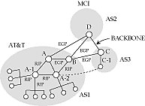
Exterior gateway protocol
Between untrusted routers
  mutually suspicious
Must tell a border gateway who can be trusted and what paths are allowed
Transit over backdoors is a problem

Slide 45
Interior protocols
Much easier to implement
Typically partition an AS into areas
Exterior and summary records used between areas

Slide 46

Routing within a broadcast LAN
What happens at an endpoint?
On a point-to-point link, no problem
On a broadcast LAN
  is packet meant for destination within the LAN?
  if so, what is the datalink address ?
  if not, which router on the LAN to pick?
  what is the router’s datalink address?

Slide 47
Internet solution
All hosts on the LAN have the same subnet address
So, easy to determine if destination is on the same LAN
Destination’s datalink address determined using ARP
  broadcast a request
  owner of IP address replies
To discover routers
  routers periodically sends router advertisements
    with preference level and time to live
  pick most preferred router
  delete overage records
  can also force routers to reply with solicitation message

Slide 48
Redirection
How to pick the best router?
Send message to arbitrary router
If that router’s next hop is another router on the same LAN, host gets a redirect message
It uses this for subsequent messages

Slide 49
Multicast routing
Unicast: single source sends to a single destination
Multicast: hosts are part of a multicast group
  packet sent by any member of a group are received by all
Useful for
  multiparty videoconference
  distance learning
  resource location

Slide 50
Multicast flavors
Unicast: point to point
Multicast:
  point to multipoint
  multipoint to multipoint
Can simulate point to multipoint by a set of point to point unicasts
Can simulate multipoint to multipoint by a set of point to multipoint multicasts
The difference is efficiency

Slide 51

Multicast routing protocol
Interface on “shortest path” to source depends on whether path is real or virtual
Shortest path from E to A is not through C, but F
  so packets from F will be flooded, but not from C
Need to discover shortest paths only taking multicast-capable routers into account
  Distance-vector Multicast routing protocol (DVMRP)

Slide 52
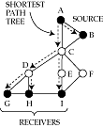
Shortest path tree
Ideally, want to send exactly one multicast packet per link
  forms a multicast tree rooted at sender
Optimal multicast tree provides shortest path from sender to every receiver
  shortest-path tree rooted at sender

Slide 53
Routing vs. policy routing
In standard routing, a packet is forwarded on the ‘best’ path to destination
  choice depends on load and link status
With policy routing, routes are chosen depending on policy directives regarding things like
  source and destination address
  transit domains
  quality of service
  time of day
  charging and accounting
The general problem is still open
  fine balance between correctness and information hiding

Slide 54
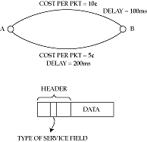
Multiple metrics
Simplest approach to policy routing
Advertise multiple costs per link
Routers construct multiple shortest path trees

Slide 55
Problems with multiple metrics
All routers must use the same rule in computing paths
Remote routers may misinterpret policy
  source routing may solve this
  but introduces other problems (what?)

Slide 56
Provider selection
Another simple approach
Assume that a single service provider provides almost all the path from source to destination
  e.g. AT&T or MCI
Then, choose policy simply by choosing provider
  this could be dynamic (agents!)
In Internet, can use a loose source route through service provider’s access point
Or, multiple addresses/names per host

Slide 57

Crankback
Consider computing routes with QoS guarantees
Router returns packet if no next hop with sufficient QoS can be found
In ATM networks (PNNI) used for the call-setup packet
In Internet, may need to be done for _every_ packet!

Slide 58
Mobile routing
How to find a mobile host?
Two sub-problems
  location (where is the host?)
  routing (how to get packets to it?)
We will study mobile routing in the Internet and in the telephone network

Slide 59
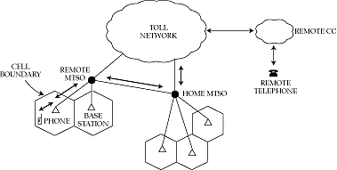
Mobile cellular routing
Each cell phone has a global ID that it tells remote MTSO when turned on (using slotted ALOHA up channel)
Remote MTSO tells home MTSO
To phone: call forwarded to remote MTSO to closest base
From phone: call forwarded to home MTSO from closest base
New MTSOs can be added as load increases

Slide 60
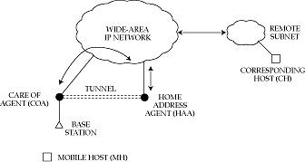
Mobile routing in the Internet
Very similar to mobile telephony
  but outgoing traffic does not go through home
  and need to use tunnels to forward data
Use registration packets instead of slotted ALOHA
  passed on to home address agent
Old care-of-agent forwards packets to new care-of-agent until home address agent learns of change

Slide 61
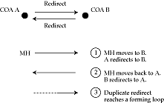
Problems
Security
  mobile and home address agent share a common secret
  checked before forwarding packets to COA
Loops

Slide 62
Thank You

